Slide 1




Storytelling Case Study:
Airbnb, NYC
Submitted By:
Avni Shrivastava
Roshani Srivastava
Muna Sahu

Slide 2

Objective
Improve our strategy to minimize the economic and commercial effects of Covid-19 on Airbnb, New York City.
Understand client preferences and trends in user experience for Airbnb in New York City.
Provide recommendations for fresh acquisitions and customer experience enhancement.
1
Submitted By: Avni Shrivastava, Roshani Srivastava & Muna Sahu

Slide 3

Background
Due to travel limitations imposed by the Covivirus-19 epidemic, Airbnb's income decreased significantly.
Now that the restrictions have started lifting and people have started to travel more, Airbnb wants to make sure that it is fully prepared for this change.
So, analysis has been done on a dataset consisting of various AirBnb listings in New York.
2
Submitted By: Avni Shrivastava, Roshani Srivastava & Muna Sahu

Slide 4
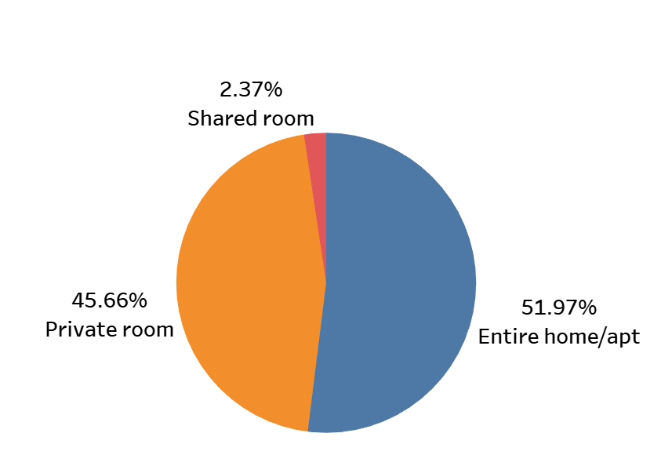
Customer Preferences of the Three Property Types
Airbnb hosts providing rentals in New York City favour Entire home/apartment and Private room above shared rooms.
The room types 'Entire home/apartment' and 'Private room' account 51.97% and 45.66% of the listed properties in New York City, respectively.
Only 2.37 % of all listed properties have shared rooms.
3
Submitted By: Avni Shrivastava, Roshani Srivastava & Muna Sahu

Slide 5
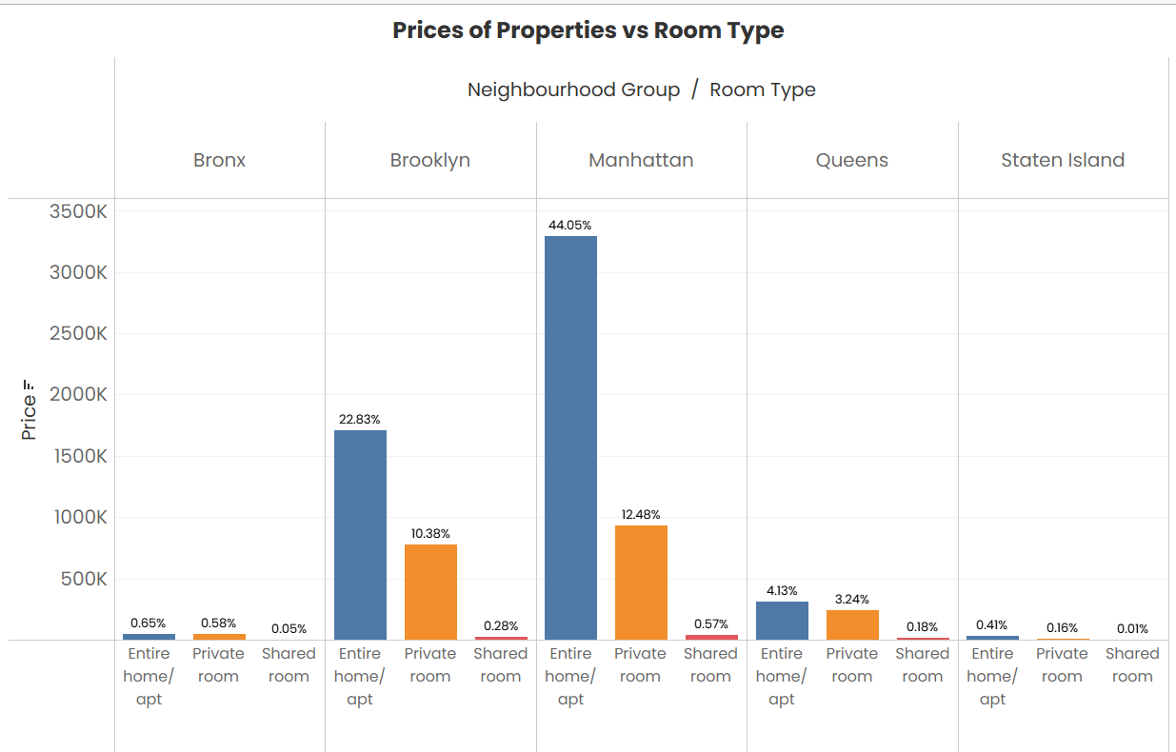
Prices of Properties and Room Type in Neighbourhood Group
Manhattan has the most expensive rental properties followed by Brooklyn , while Bronx and Staten Island have the least expensive.
The most costly room type in both Manhattan and Brooklyn are entire homes/apartments, followed by private rooms.
In Queens and Bronx, the price differential between complete homes/apartments and individual rooms is between 5 and 10%, compared to the other neighbourhood groupings.
4
Submitted By: Avni Shrivastava, Roshani Srivastava & Muna Sahu

Slide 6
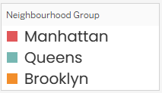
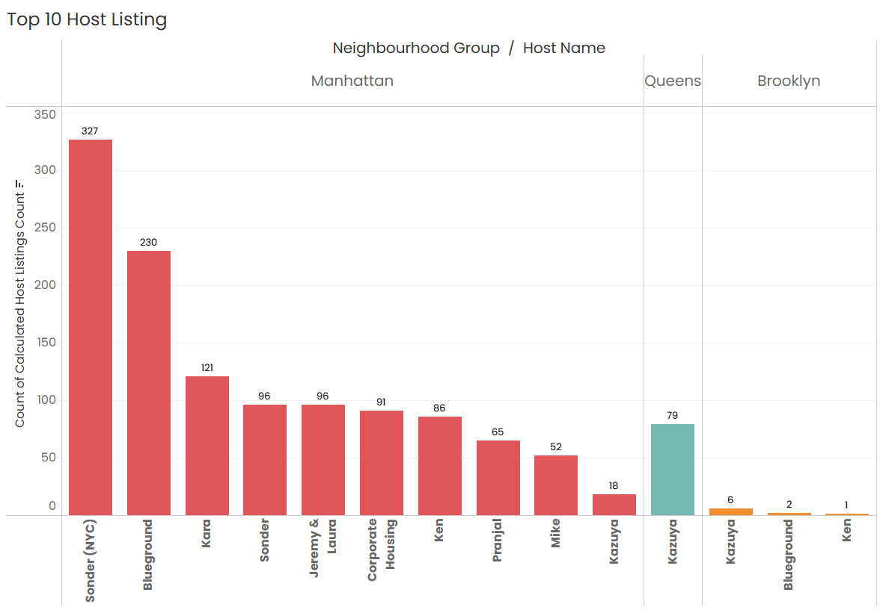
Top 10 Host Listing in the Neighbourhood
Group
Sonder(NYC) lists the most rooms in Manhattan, followed by -327, Blueground with 230 rooms.
Manhattan is the most listed neighbourhood group followed by Brooklyn and Queens.
Bronx has only one listing, although Staten Island is not in the top ten.
5
Submitted By: Avni Shrivastava, Roshani Srivastava & Muna Sahu

Slide 7
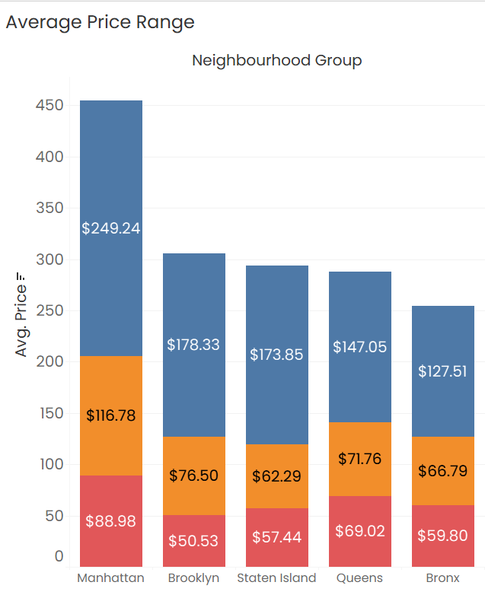
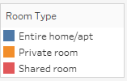
Average Prices of Properties and Room Type in Neighbourhood Group
Manhattan is the only neighbourhood category where the average price of the listed neighbourhoods is more than $200.
Brooklyn and Staten Island have average prices of $124 and $114, which are less and more affordable to Manhattan.
Queens and Bronx have average prices of $100 and $88 respectively, making them the most inexpensive areas in New York City.
6
Submitted By: Avni Shrivastava, Roshani Srivastava & Muna Sahu

Slide 8
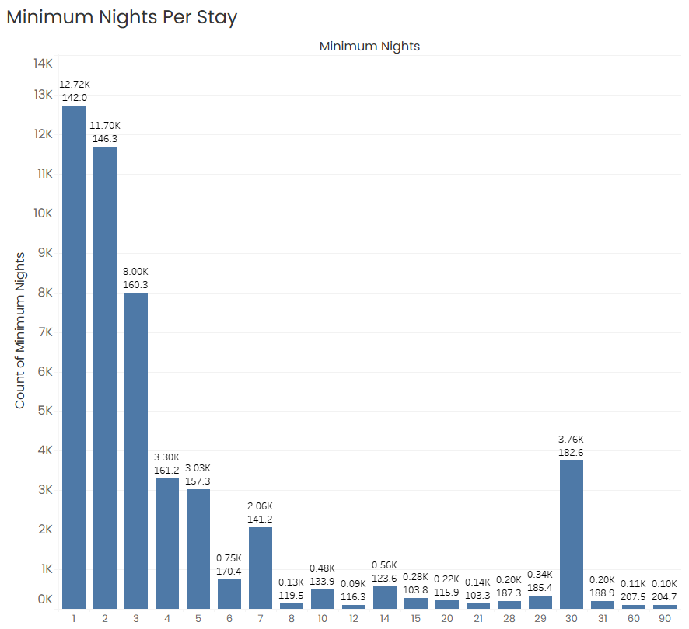
Customer Preferences of Minimum Nights Per Stay
12.7k customers prefers to stay for a day on their visit closely followed by 11.6k customers who stay for 2 nights.
Customers also prefer to stay for 3-7 nights.
Customer preferences of night stays rises on 14 nights, 30 nights.
7
Submitted By: Avni Shrivastava, Roshani Srivastava & Muna Sahu

Slide 9

Key Insights & Recommendations
Airbnb hosts providing rentals in New York City favour Entire home/apartment and Private room above shared rooms.
Manhattan has the most expensive rental properties followed by Brooklyn , while Bronx and Staten Island have the least expensive.
Customer preferences of night stays rises on 14 nights, 30 nights.
8
Submitted By: Avni Shrivastava, Roshani Srivastava & Muna Sahu

Slide 10
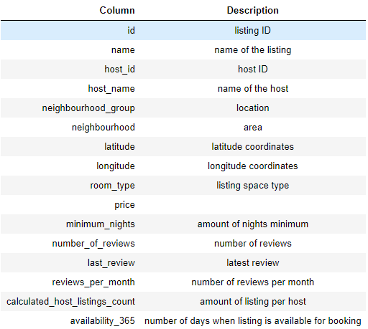
APPENDIX - DATA SOURCES
The New York Airbnb Dataset includes information on various Airbnb listings, including their hosts, locations, pricing, and other characteristics. The dataset's columns are self-explanatory.
We reviewed the dataset description on the right to gain a better understanding of what each column represents.
9
Submitted By: Avni Shrivastava, Roshani Srivastava & Muna Sahu

Slide 11
APPENDIX – DATA METHODOLOGY
A thorough analysis of the Airbnb Data was conducted. This process included
Cleaning the data set for missing values and outliers.
Using exploratory data analysis to identify customer preferences based on :
Locality/ Neighbourhood
price
No. of Reviews
Minimum nights stay
Room Type
Host ID/Name
(Refer to Methodology Document for details)
10
Submitted By: Avni Shrivastava, Roshani Srivastava & Muna Sahu

Slide 12
APPENDIX - DATA ASSUMPTIONS
In this case study, it is believed that Airbnb was able to reach the targeted level of revenue and profit prior to the implementation of COVID 19, and the data supports this assumption.
The company is not now seeking to expand to additional cities around New York City.
After global COVID-19 limitations are loosened, the business plans will be developed in light of the anticipated increase in travel.
11
Submitted By: Avni Shrivastava, Roshani Srivastava & Muna Sahu

Slide 13
Storytelling Case Study:
Airbnb, NYC
Thank You…
Submitted By:
Avni Shrivastava | Roshani Srivastava | Muna Sahu
upGrad & IIITB
Data Science Program - April 2022
12

